Slide 1
Human articular chondrocytes
Primary cultured cells, supplied by GSK
Currents activated by GSK compound SB488

Slide 2
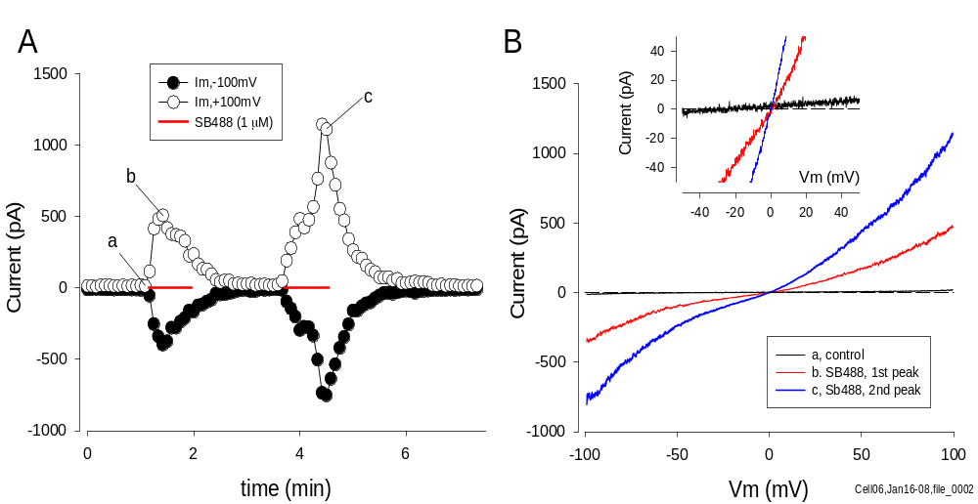
Response of human articular chondrocyte to SB488
Whole-cell, Cs⁺ pipette solution, low internal [Ca²⁺]
c
b
a
Notes:
SB488-induced currents in a HAC. A. Time course of membrane current at +100 and -100mV during repeated ramp voltage-clamp protocols. Red bars indicate application of 1 uM SB488. B. IV relations before (trace ‘a’, control, indicated in Figure A) and during application of SB488 (b,c). The region of the IV plots near 0 mV is shown on expanded potential and current scales in the inset plot. Whole cell recordings with CsCl-rich pipette solution. HAC was in cell culture for 5 da. Cm=6.1 pF.

Slide 3
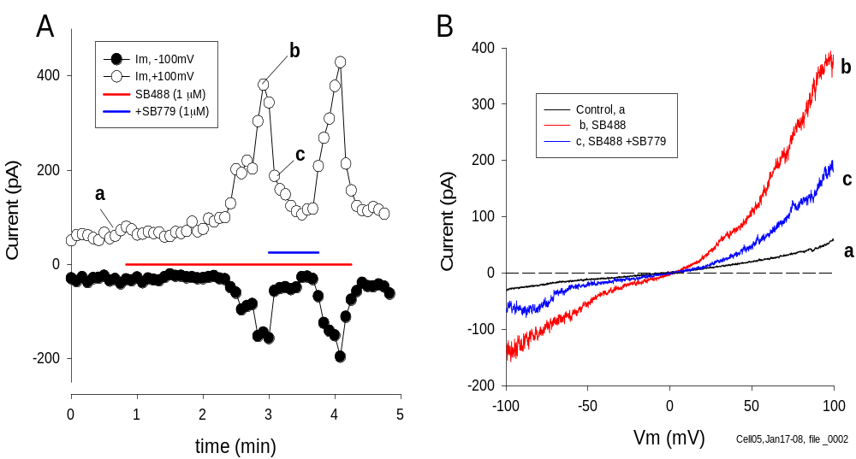
SB779 antagonizes response to SB488 in human articular chondrocytes
Whole cell, Cs⁺ pipette solution, low internal [Ca²⁺]
Notes:
Antagonism of SB488-induced currents by SB779. A. Time course of membrane current at +100 and -100 mV during repeated ramp voltage-clamp protocols. Colored bars indicate application of 1 mM SB488 (red), or SB488 + (1 mM) SB779 (blue). Note nearly complete inhibition of SB488-induced current by SB779. B. IV relations before (a), during SB488 (b) and during SB488+SB779 (c). The HAC was in cell culture for 6 da. Cm= 14.5 pF. [THIS]

Slide 4
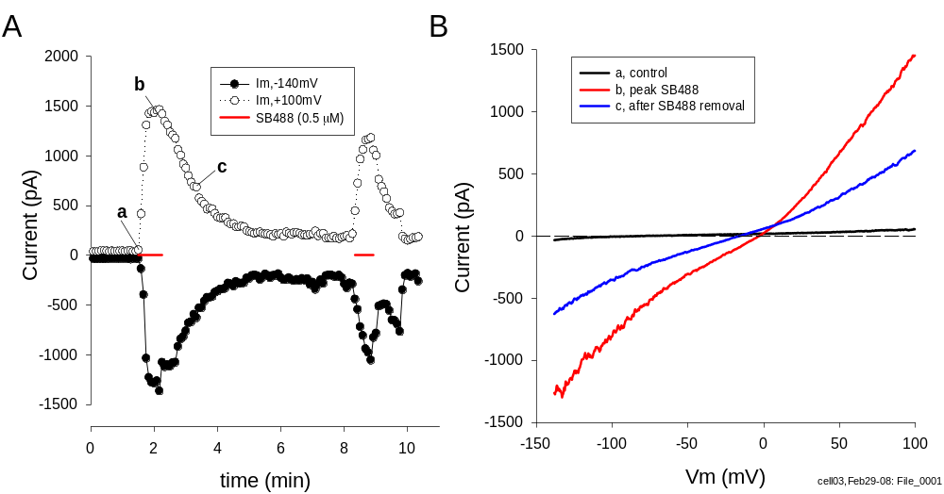
Response of human articular chondrocyte to SB488
Amphotericin-perforated recording, Cs⁺ pipette solution
b
c
a
Notes:
Response of a HAC to SB488; amphotericin-perforated voltage-clamp. Patch pipette contained CsCl-rich solution to block K+ currents. A. Time course of current at +100 and -140mV during repeated ramp protocols. The HAC was briefly exposed twice to SB488 (0.5 mM). B. Selected IVs before (a, control), during (b), and after (c) exposure to SB488. Note that the ramp protocol in this experiment was from -140 to +100 mV. The HAC was in cell culture for 2 da. Cm=10.9 pF.

Slide 5
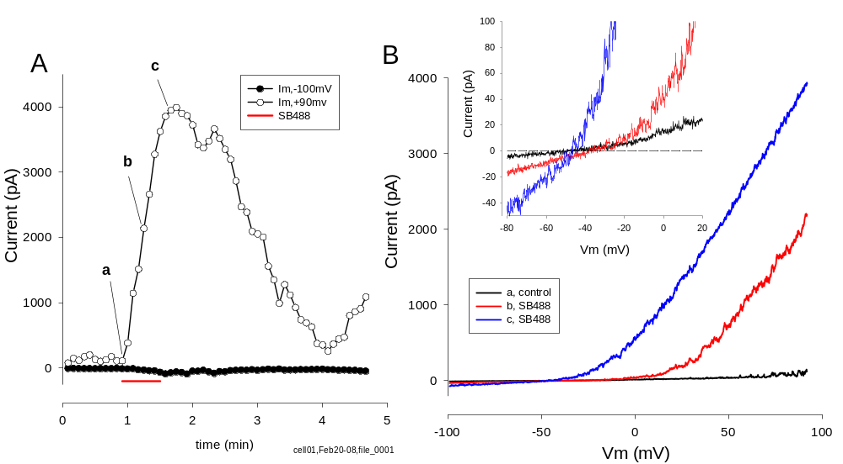
SB488 activates large outward currents in amphotericin-perforated human articular chondrocytes
K⁺ pipette solution
Notes:
Activation of K+ currents by SB488 in amphotericin-perforated HAC. A. Time course of current changes produced by SB488 in a voltage-clamped HAC. Currents were measured at +90 and -100mV during repeated ramp voltage-clamp protocols. SB488 (0.5 υM) was applied during red bar. Note very large outward current activated during SB488 application. B .Ramp IV relations at time indicated in A (‘a,b,c’). C. IVs from B on expanded current and membrane potential scales to show reversal potentials. Cell was in culture for 2 da. Cm= 8.0 pF. D. IVs, from different cell, showing effect of TEA (5 mM) on currents activated by SB488 (0.5 mM). Note that the ramp potential was between -140 and +100 mV. The cell was in culture for 2 da. Cm=17.3 pF.

Slide 6
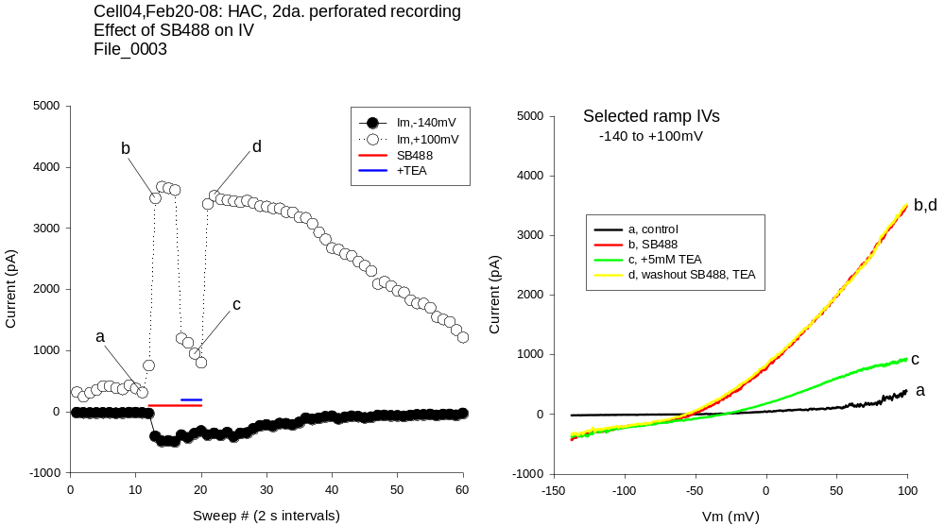
TEA blocks most of the outward current activated by SB488 in amphotericin-perforated human articular chondrocyte
K⁺ pipette solution
Notes:
TEA blocks most of the large outward current activated in amphotericin-perforated HAC.
Left: Time-course of ramp IV currents (at -140 and +100mV) during application of 1 uM SB488, and 5 mM TEA-Cl. SB488 activated a very rapid rise in outward current in this cell, which was very substantially blocked by 5mM TEA, added in the presence of SB488. Removal of TEA resulted in a very rapid restoration of outward current. Right: Selected ramp IVs, during time course at left. ‘a’ is the control immediately preceding application of SB488. ‘b’ is close to the maximal response to SB488. ‘C’ is during addition of 5mM TEA-Cl to the SB488-containing solution. Note substantial inhibition of outward current by TEA, with almost no effect on the inward limb of the IV. ‘d’ is shortly after washout of TEA (and SB488).

Slide 7
Summary
Currents activated in HAC by SB488
Non-selective Cation current
-Weakly outwardly rectifying, with reversal potential ~0 mV. Similar
to mouse articular chondrocytes, probably TRPV4
-Activated in whole-cell (‘low’ internal Ca²⁺) and amphotericin- perforated recording conditions
-Current activation reversibly antagonized by SB779
Ca²⁺ -activated K⁺ current
-‘BK’ current activated by SB488
-SB488 increases internal Ca²⁺; via ion channels from extracellular
space (?)
Notes:
Currents activated by SB488 application. Principally non-selective cation current (TRPV4 ??), and BK channels, by raising intracellular Ca2+ concentration.

